Slide 1


Campaign Planning
These materials were produced for InsideSherpa and to be used for educational and training purposes only.

Slide 2
Attracting more companies
It is found out in performance analysis that most of the Citi’s revenue comes from corporates.
Citi can take this as an advantage and could try advertising their corporate banking services to companies which doesn’t bank with Citi .
They could provide a certain amount of discount on foreign transaction fee for newly joined companies.
Advertisement can be done through Social media & email campaign .

Slide 3
Sample Campaign mail
Dear company,
Greetings from Citi Bank. We would like to bring our best corporate banking services which are trusted by many Industry leaders to you. We have a special offer for you. We are offering discount on transactional fee for reputed company like yours for a limited period of time.
We highly respect our client’s concern and try to provide them with the best interest rates and other facilities. Our online banking app is used by many companies like yours as we provide secure, personalised and convenient way of banking which differentiate us from others. Hoping to hear from you. Kindly reach to our customer care no. 123456789 or feel free to mail us at any time.
Regards
Citi Bank

Slide 4
Giving offers to Partnerships & Individual Segment
It has been found out in performance analysis that Individuals & Partnerships use the product near half that of companies and VIP’s.
Citi can target those two segments by offering them more customized and personalized services like cashbacks, offering discount on transactions, partnering with 3rd party such as e-commerce platforms for attractive offers on products when payment is done through credit or debit card.
Citi bank can partner with amazon and could offer a discount of 10% when payment is done through their credit or debit card.
Individuals can be targeted through online & social media campaigns.
VIPs can be targeted through offering them services like fund management, investment advices, Tax consultant, etc.

Slide 5
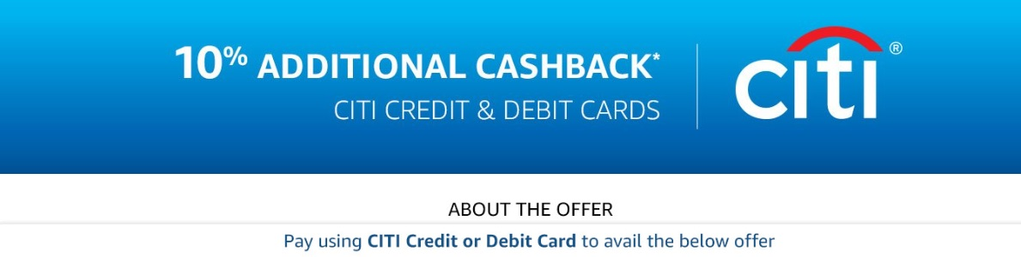
Campaign sample

Slide 6
APP based Referral program for existing users and new users
Citi can roll out app based referral program where an existing customer can refer their friends to open an digital account with Citi.
Both existing & new customers would get $100 or so as a coupon or cashbacks on successful referrals.
Since Citi’s main customers acquisition channels are online organic search & targeted online ads, this program could be advertised through these two channels immensely.
This referral program could help Citi to hold on to their existing customers as well as acquiring new customers.

Slide 7
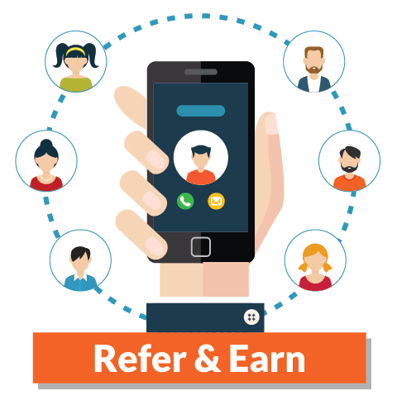
Sample ad for referral program

